Slide 1
Category review: Chips
June 2020
Retail Analytics
Brand note: If client logo is not required, use alternate title page layout right click slide thumbnail > Layout > Title

Slide 2
Notes:
To view Privacy video explaining how important data privacy is to Quantium, please click here: https://www.youtube.com/watch?v=Zq1QDAkoRzU
or here Q:\Company Reference\Brand & Design\Brand videos\Q Privacy.mp4
At Quantium, we believe that data is the behavioural footprint of humanity and that it has to be treated with the utmost care and responsibility.
Histories, attitudes, indeed lives are stored within it in ways that aren’t always apparent – and that’s what makes its potential so powerful.
To work with it responsibly, sensitively, we set ourselves the highest data privacy protection and governance standards.
We have spent 17 years perfecting privacy-by-design and secure-by-design principles. Central to this is not holding any personally identifiable information about people –
we neither receive it, and put the necessary protections in place to be unable to decipher it.
Every aspect of handling data is safeguarded: from its de-identification, to its encryption – data security is paramount and of the highest grade.
We pride ourselves on gaining the trust of iconic organisations around the world through years of securely working with their data,
and in turn the trust that builds with their stakeholders.

Slide 3
Executive summary
01
Category Review
Most sales are related to Older Families in the Budget category, followed by the Young Singles/Couples in the mainstream category then Retirees also in the mainstream category.
Most ordered product: Kettle Mozzarella Basil & Pesto 175g.
We have the most amount of orders and brand products and sales from Kettle Brand
The least amount of orders from French Brand.
We have more sales on packages between the size of 150g and 200g
Most customers are multipack buyers. Of all the orders 89.6% of orders are of multiple quantities.
Spike up in sales just before the new year which represents the month of December
02
Trial Store Performance
Trial had a significant impact on increasing the number of customers and total sales in trial store 77
Trial had a significant impact on increasing the number of customers in trial store 86
but, sales were not significantly higher.
Trial had a significant impact on increasing the number of customers and total sales in trial store 88
Generally the trial was impactful on total sales and number of customers.

Slide 4
01
Category Review

Slide 5
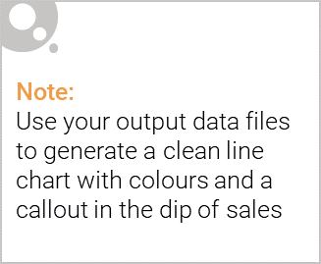
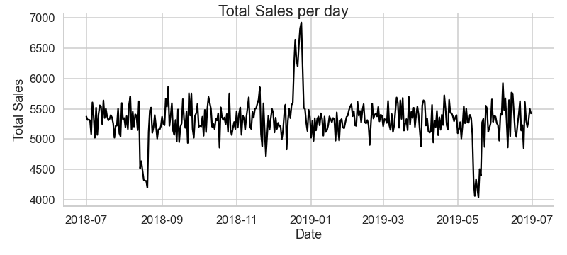
There is a significant spike up in sales just before the new year which represents the month of December
There are significant spikes down in sales late in the month of august 2018 and may 2019 (could be due to climatic factors)

Slide 6

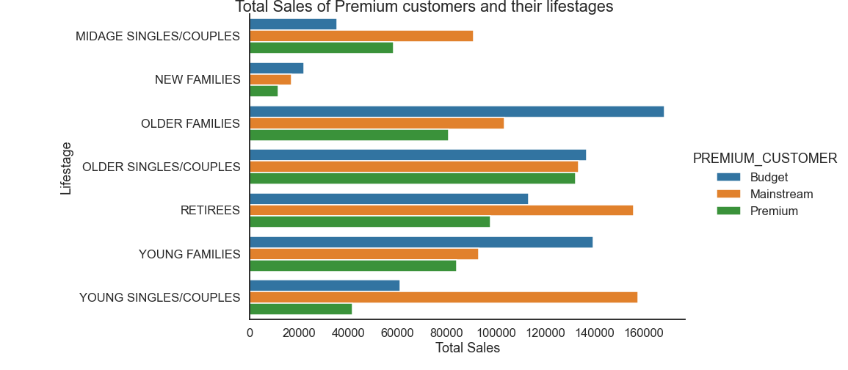
Most sales came from Older Families in the Budget category, followed by the Young Singles/Couples in the mainstream category then Retirees also in the mainstream category.
New families have the lowest sales in all categories.

Slide 7
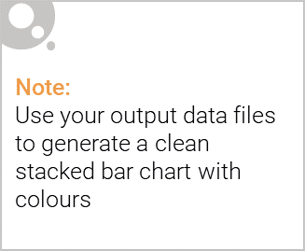
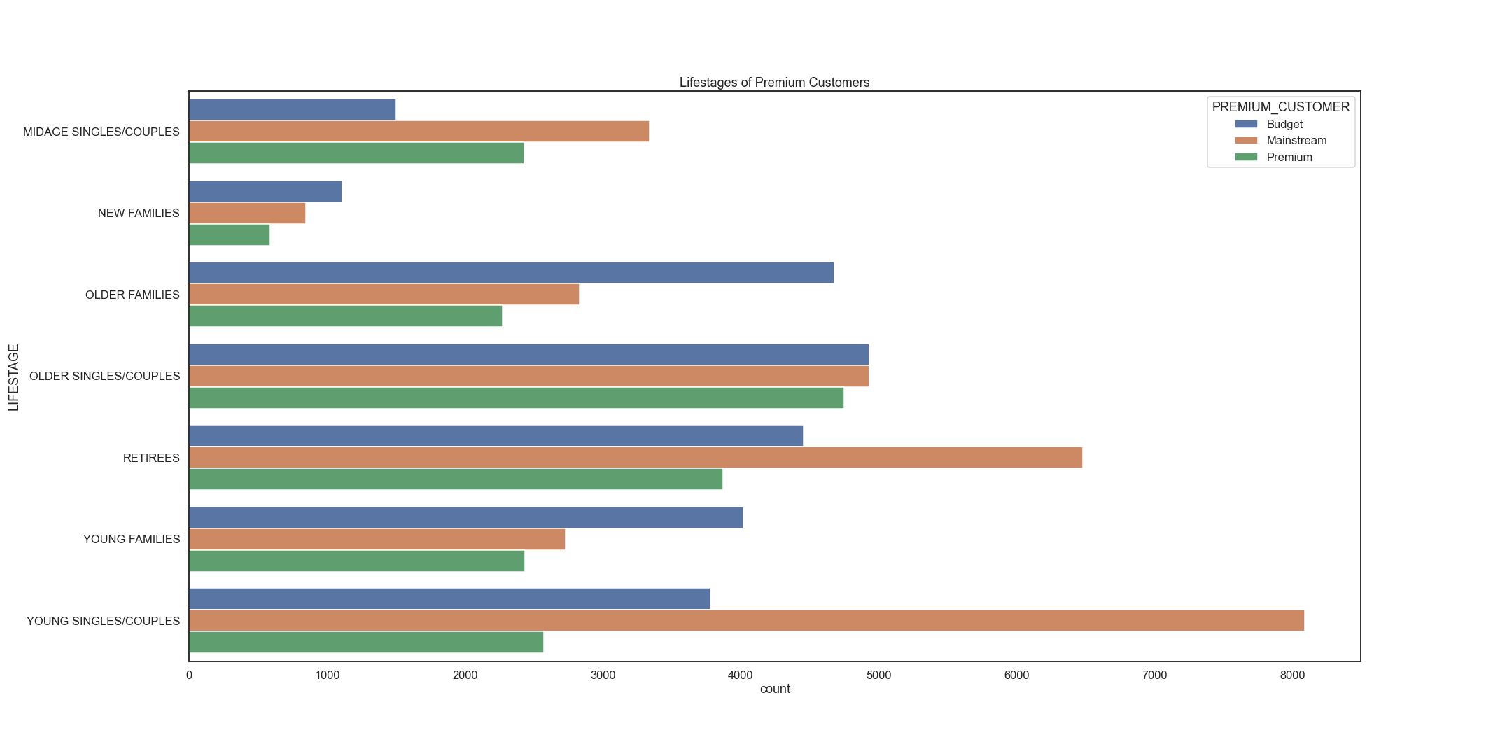
Editable (delete this)
The category with the most customers is the mainstream category of Young singles/couples, followed by the mainstream category of retirees.

Slide 8
02
Trial store performance

Slide 9
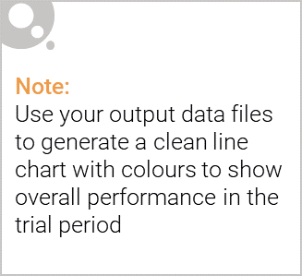
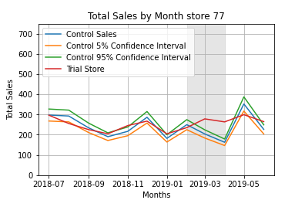
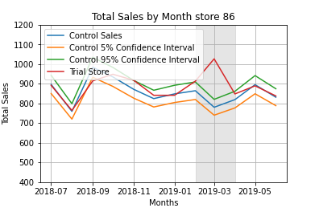
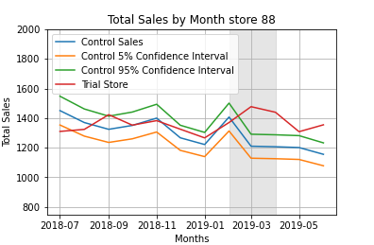
Trial Store 77: Control store 233
Trial Store 86: Control store 155
Trial Store 88: Control Store 237
There’s a general increase in total sale throughout the 3 stores during the trial period. Trial for Store 77 and 88 is above the 95% confidence level for two (2) months out of three (3), while that of store 86 is above the 95% confidence level for one (1) month out of three (3).
Generally trial has positive impact on total sales in the 3 stores

Slide 10
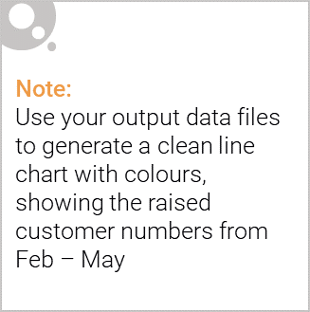
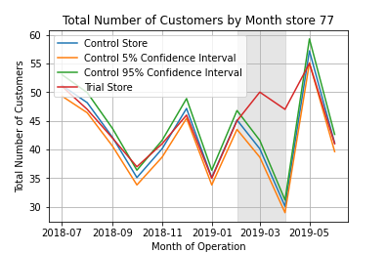
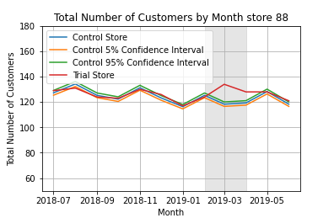
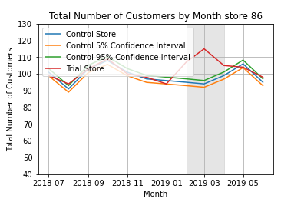
Trial Store 77: Control store 233
Trial Store 86: Control store 155
Trial Store 88: Control Store 237
There’s also a general positive outcome of trial on total number of customers.
Trial is above 95% for at least two (2) months in the three stores.
Overall, the trial had positive Impact on total number of customers.

